Slide 1

DEEPWATER DRILLING OPERATIONS GOING FORWARD
A Discussion with Industry Leaders

Slide 2
DEEPWATER DRILLING OPERATIONS GOING FORWARD
A Discussion with Industry Leaders
Participants / Agenda:
Deepwater Well Design Task Force – John Peters Chevron
Deepwater Well Operating Procedures – George Coltrin – Nexen &
Ron Sweatman – Halliburton
Deepwater Well BOP/Equipment Task Force – Moe Plaisance – Diamond Offshore
Subsea Well Control and Containment Task Force, - Charlie Williams – Shell
Oil Spill Response Task Force – Keith Robson – Marathon

Slide 3
Joint Industry Task Force for Offshore Operating Procedures
API RP 96 – Deepwater Well Design Considerations
George Coltrin, Nexen
Ron Sweatman, Halliburton
John Peters, Chevron

Slide 4
JITF for Operating Procedures
JITF met for ~2 weeks in May to develop recommendations for DOI.
Identify best practices with offshore D&C ops using Subsea BOP’s
Focused on (5) areas:
  Cementing – refer to API RP65 Part 2
  Wellbore loads and casing resistance
    Casing hanger assembly locked into Subsea wellhead
    Phase 2 study – provide well design considerations (now API RP 96)
  Wellbore barriers
    Two or more independent barriers for each flow path
    Testing and verification of same
  Displacing wells to lighter fluids
    With Subsea BOP closed
    Separate ops for - negative test, riser displ, and csg displ
    Monitor displacement volumes / rates in and out of wellbore
    Confirm shearable components across shear rams
  HSE Case, incl. Well Construction Interfacing Document (WCI

Slide 5
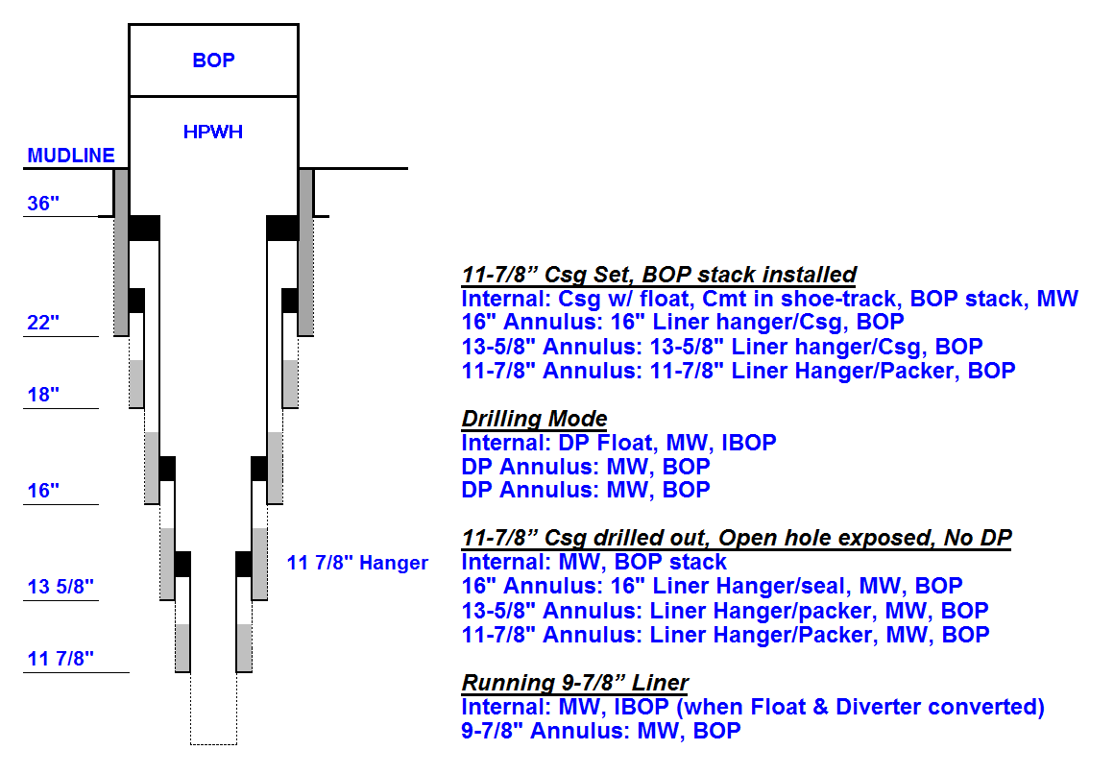
API RP-65 Part 2: “Isolating Potential Flow Zones During Drilling & Cementing”
Well Planning / Ops Guidelines
Drilling Practices
  Maintain Wellbore Stability
Mechanical Barrier Methods
  Sub-Surface Devices
  Surface/Wellhead Devices
  Alternative Devices
Cementing Practices
  "Shoe Tests" LOT
  Casing Tests, Etc.
Flow Prevention Practice Matrix
  Key Parameters
  How to use the Matrix

Slide 6
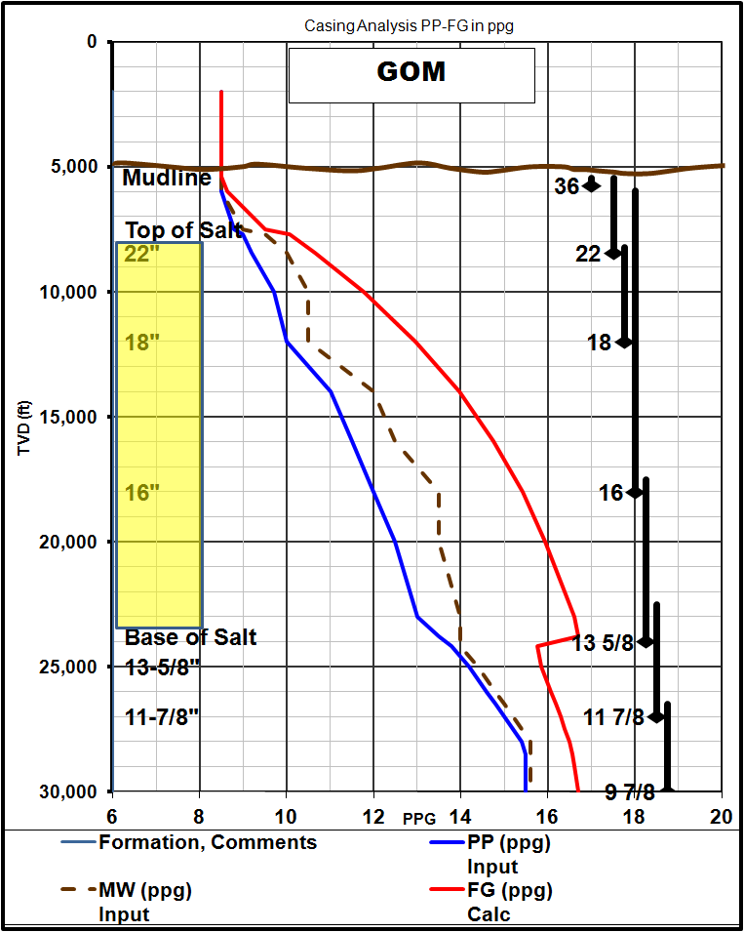
JITF Operating Procedures
API RP96 Deepwater Well Design Considerations
Loads
  HTHP, MASP, cmt, buckling
  Hanger , liner top pkr
  Drive-off /ship rotation - WH/36”
  Welded conn’s at WH / Csg
  Csg wear 22” / 16” /….
  APB – drilling / production
  ETC, Etc, etc.
Barrier - Install, Verify & Manage
  Barrier test method
  Non-testable barriers
  Fluid displacements (TA/PA)
  MOC triggers in well design
  ETC, Etc, etc.
Standard/Reference Review
  Over 30 API + Others
  Including API RP 65 Part 2

Slide 7
API RP 96 Deepwater Well Design Considerations
Forward Plan
☑ Complete
  Kick off meeting
  Develop initial outline
  Organize into sub teams and select sub team leads.
  Sub teams meet and add content to outline
  Select Engineering Consultant as tech writer
◻ In Progress
  Review and vet the sub team work
  Begin draft #1 using Engineering tech writer
◻ Outstanding
  Review draft #1
  Update draft #2
  Ballot for group consensus
  Draft #3 (if necessary)
  Send approved draft to API for 1st Edition

Slide 8
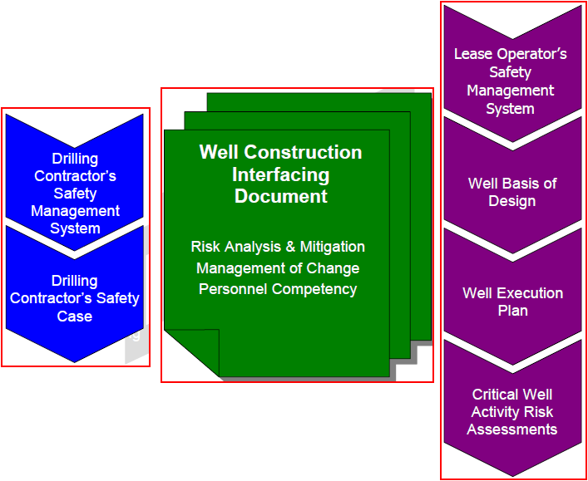
JITF Operating Procedures
WCID (Well Construction Interface Document)
Well construction interface / Basis of design
  Location & environment
  Geologic and geophysical
  Well design
  Well barriers (with much detail)
  Casing design
  Well execution plan (with detail)
  Critical well Risk Assessments
  Operator’s MOC
Drilling contractor safety case and lease operator SMS interface
  Mngt structure / RR’s / Acct
  Drilling Contractor MOC
  Personnel management
  Well control procedures
  Risk management processes
  Emergency response
  Monitoring, auditing and review

Slide 9
WCID (Well Construction Interface Document)
Forward Plan
☑ Complete
  Sub Team Kick Off meeting
  Developed initial WCID guidelines outline
  Sub Team to vet WCID outline with JITF Procedures Group
  Sub team develops additional detail and explanation
  Seek additional comment from the JITF Procedures Group
◻ In Progress
  Sub team updates draft WCID
  JITF Governance Board endorsement
Outstanding
  Release 1st edition of WCID Guidelines for general use by Industry

Slide 10
THANK YOU
A P I
Anadarko
Apache
Blade
BP
Cameron
Chevron
Cobalt
ConocoPhillips
Diamond Offshore
ENI
Expert E&P Consult
ExxonMobil
GE Oil and Gas
Halliburton
Hess
Hunting
IADC
Marathon
Nexen
Noble Energy Inc
Pacific Drilling
Petrobras
Pride Intl
Schlumberger
Shell
Statoil
Stone Energy
Stress
Transocean
USS

Slide 11
DEEPWATER DRILLING OPERATIONS GOING FORWARD
A Discussion with Industry Leaders
Participants / Agenda:
Deepwater Well Design Task Force – John Peters Chevron
Deepwater Well Operating Procedures – George Coltrin – Nexen &
Ron Sweatman – Halliburton
Deepwater Well BOP/Equipment Task Force – Moe Plaisance – Diamond Offshore
Subsea Well Control and Containment Task Force, - Charlie Williams – Shell
Oil Spill Response Task Force – Keith Robson – Marathon

Slide 12
API Joint Industry Task Force (JITF) – Equipment Group
Team Leader – Moe Plaisance

Slide 13
JITF ‘White Paper’
Main Points
Safety Case Regime
A robust MOC process
Suggested to add Autoshear or Deadman to floating rigs
Suggested for industry standard to use API Spec 17H ROV stabs
Current Technology Acoustic Systems must be Evaluated (due to poor past performance)

Slide 14
JITF Workgroups
Shearing Workgroup
  Work on having the industry share all shearing data
  Equipment OEM’s are checking on storing and maintaining the information on their company websites for easy access by the industry
ROV Workgroup
  Work on ROV unit standards for GOM that are reasonable for current technology

Slide 15
Present to BOEMRE an Unsolicited Suggestion List before Rulemaking Occurs
Listing suggestions to give to the BOEMRE to hopefully influence the rulemaking
Not finalized, still being worked

Slide 16
DEEPWATER DRILLING OPERATIONS GOING FORWARD
A Discussion with Industry Leaders
Participants / Agenda:
Deepwater Well Design Task Force – John Peters Chevron
Deepwater Well Operating Procedures – George Coltrin – Nexen &
Ron Sweatman – Halliburton
Deepwater Well BOP/Equipment Task Force – Moe Plaisance – Diamond Offshore
Subsea Well Control and Containment Task Force, - Charlie Williams – Shell
Oil Spill Response Task Force – Keith Robson – Marathon

Slide 17
Industry Task Force
Subsea Well Control and Containment Task Force
14th Annular Deepwater Technical Symposium
Charlie Williams – Shell – Task Force Leader

Slide 18

Restoring Confidence in Deepwater Drilling Operations
  Spill Response Capability
  Well
  Containment & Intervention Capability
Safe
Drilling
Operations
Industry Drilling
Standards
Our initiatives are aligned with Administration / Congressional expectations of how to resume safe drilling operations in the Gulf of Mexico

Slide 19
Subsea Well Control and Containment Task Force
Sub Groups
Well Containment at the Seafloor
Leader: Chris Nelson
Intervention and Containment Within the Subsea Well
Leader: Steve Pierce
Subsea Collection and Surface Processing and Storage
Leader: Jon Gean

Slide 20
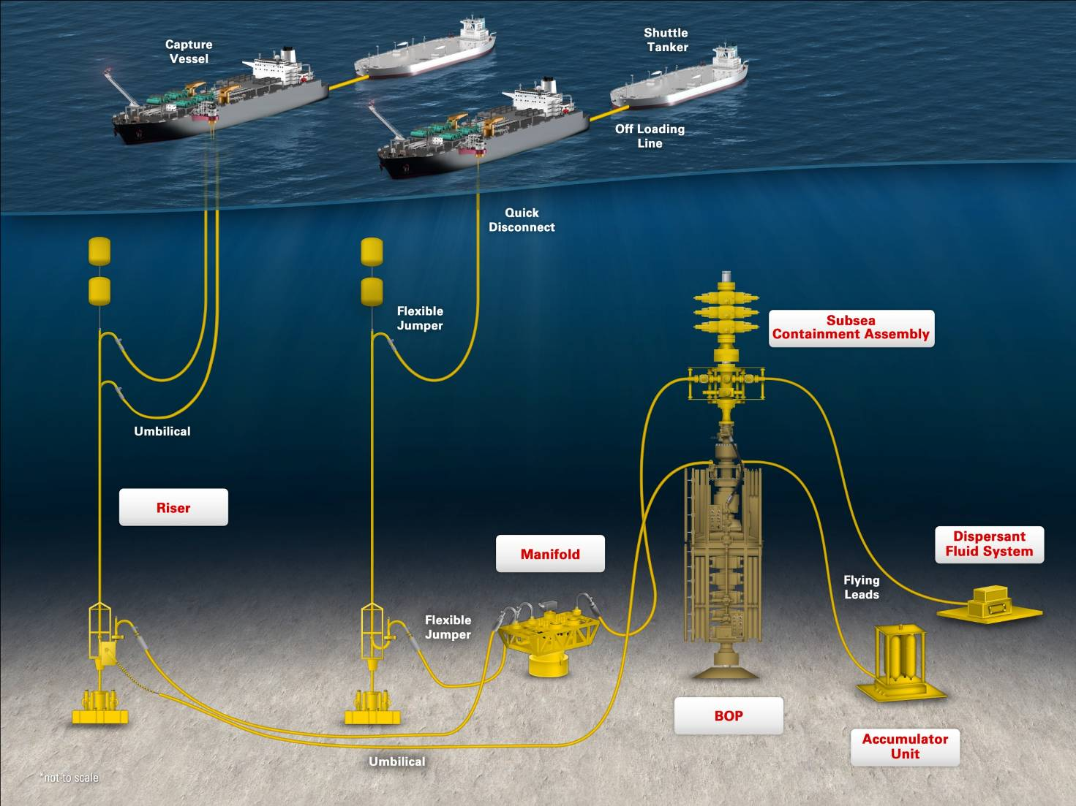
Marine Well Containment Co. (MWCC) Project
  This flexible and adaptable system includes subsea containment equipment connected by risers to vessels that will safely capture, store and offload the oil

Slide 21
Subsea Well Control and Containment Task Force
The Task Force will review and evaluate:
current capacities
identify & recommend areas for improvement
develop & implement a strategy to address needs & requirements
- equipment
- practices
- industry standards
to improve preparedness & response in subsea containment & intervention.
Materials produced from the Task Force will be delivered to:
Congress
The Administration
National Commission on the BP Deepwater Horizon (DH) Oil Spill and Offshore Drilling (Presidential Commission).

Slide 22
DEEPWATER DRILLING OPERATIONS GOING FORWARD
A Discussion with Industry Leaders
Participants / Agenda:
Deepwater Well Design Task Force – John Peters Chevron
Deepwater Well Operating Procedures – George Coltrin – Nexen &
Ron Sweatman – Halliburton
Deepwater Well BOP/Equipment Task Force – Moe Plaisance – Diamond Offshore
Subsea Well Control and Containment Task Force, - Charlie Williams – Shell
Oil Spill Response Task Force – Keith Robson – Marathon

Slide 23
Joint Industry Task Force to Address
Oil Spill Preparedness and Response
Keith C. Robson – Co-chair – Marathon Oil
Jay Collins – Co-chair - Oceaneering

Slide 24
Participants
Marathon
ExxonMobil
Chevron
Shell
ConocoPhillips
Aramco Services
Anadarko
BP
Apache
Statoil
Petrobras
GE Oil & Gas
HESS
LOOP
Tesoro
American Petroleum Association
Independent Petroleum Association of America
Oceaneering
Baker Hughes
Marine Spill Response Corporation
National Response Corporation
Oil Spill Response
Clean Gulf Associates
Oil Mop
Research Planning
Polar Applied Sciences
American Pollution Control
Tidewater
C&C Technologies
Dynamic Offshore
Wild Well Control
National Ocean Industries Association

Slide 25
Vision of Success
PHASE 1: Short-term (July 2 respond to on-going Congressional efforts)
Identify gaps and potential areas needing improvement
Develop components to address gaps and areas of improvement:
    Sub groups
    Strategy
    Action Plan
PHASE 2: Mid Term (August 25, 2010)
Interim recommendations will be developed and communicated to Presidential Commission
PHASE 3: Long Term (December 31, 2010):
Provide report detailing progress and activities
Identify next steps/milestones

Slide 26
Work Plan & Scope
Work Plan:
Review industry data associated with oil spill preparedness and response with the objective of identifying gaps, issues, areas of concern, etc.
Benchmark practices against best-in-class practices and against existing regulations.
Identify opportunities to create industry best practices.
Review findings from Deepwater Horizon incident response to identify improvements that can be made to oil spill response for the industry overall.
Issue initial recommendations at end of Phase 1.
Liaison with other initiatives around the world
Boundary Conditions:
In Scope
Classic Oil Spill Response Issues
  “When oil is in the water”
Out of Scope
Subsea well control and containment techniques

Slide 27
Focus Areas
Oil Spill Planning
Mechanical Recovery & Containment
Shoreline Protection & Clean-up
Dispersants
  Surface
  Sub-surface
Oil Sensing & Tracking
In-Situ Burn
Alternative (Inventive - Innovative) Technologies
Funding

